Slide 1
CrowdSource Litter Pickup

Slide 2
Purpose and Goal
Purpose: The purpose of our application is to be a place that organizations and volunteers can use to find high concentrations of litter as reported by everyday users using the application in order to help cleanup.
Goals: The goal of our project is to design and implement a website that allows community members to report littered areas and enables volunteer organizations and city officials to coordinate cleanup efforts. By integrating an interactive map, user-submitted data, and automated analysis of litter hotspots, our system aims to improve environmental conditions, promote civic responsibility, and enhance the quality of life in local communities.

Slide 3
Group Members and Project Advisor
Members:
Zach Reising - reisinzs@mail.uc.edu - (513) 515-9153
Jacob Towne - townejd@mail.uc.edu - (513) 827-8184
Michael Mazzella - mazzelma@mail.uc.edu - (859) 468-0333
Tommy Tuttle - tuttlett@mail.uc.edu - (969) 969-6969
Project Advisor:
Badri Vellambi - vellambn@ucmail.uc.edu -

Slide 4
Abstract
The focus of our project is to design and implement a crowdsourced litter pickup website that empowers community members to mark and report locations of heavy litter accumulation in their neighborhoods. This geotagged data will be shared with volunteer groups, nonprofit organizations, and city officials to help prioritize and coordinate cleanup efforts efficiently. Our project integrates front-end web development, backend database management, and interactive user engagement features to create a seamless experience. By combining technology, civic participation, and environmental sustainability, this platform promotes greater community involvement in maintaining cleaner, healthier public spaces.

Slide 5
User Stories
Design and structure the Home page interface
Design and implement the Login/Signup module
Design the User Dashboard layout and features
Design the Maps feature interface
Design and implement the groups module
Develop Authentication services
Design and implement the Database schema
Develop Map Services APIs
Design and implement AI image Processing module
Develop Group Management backend
Develop Notification System
Schedule and manage Cron Jobs

Slide 6
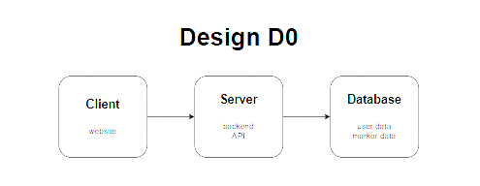
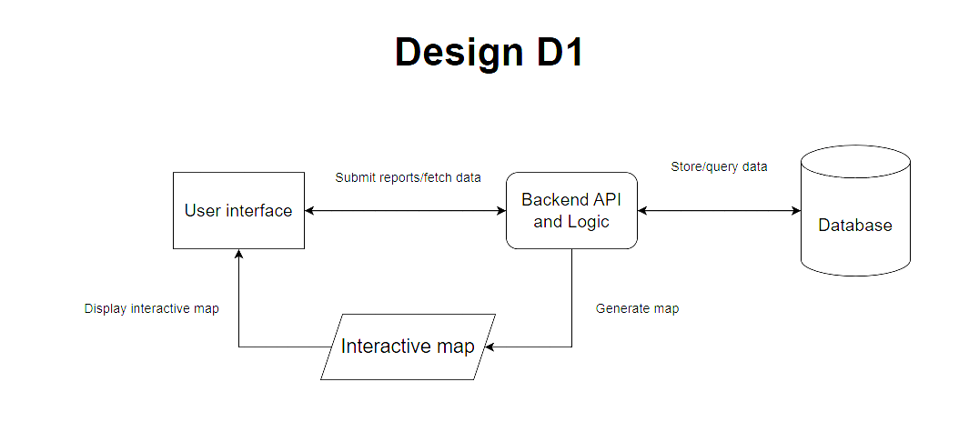
Design Diagrams

Slide 7
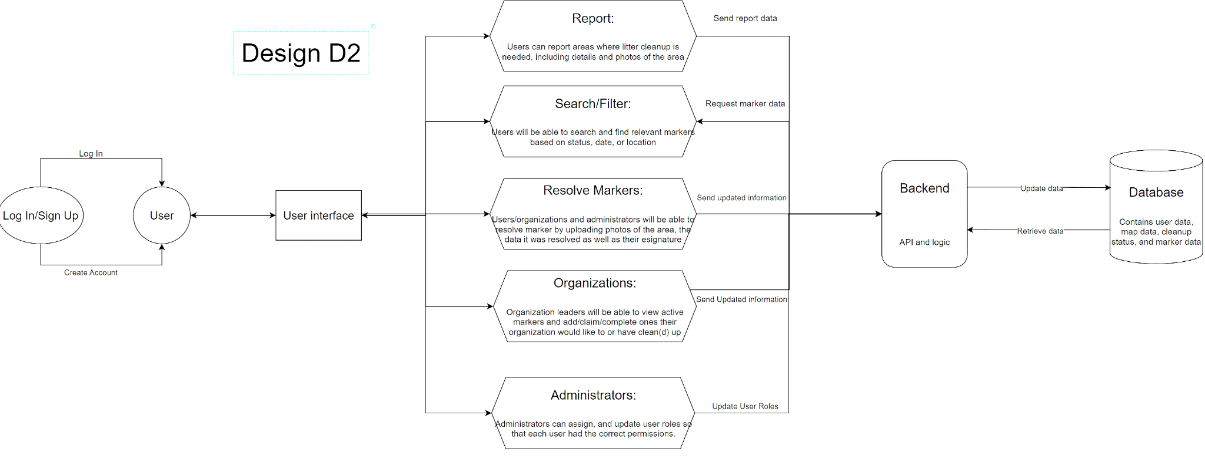
Design Diagrams

Slide 8
Constraints
Social: Ensure the app is user-friendly and improves community coordination and quality of life.
Environmental: Identify and reduce litter in public spaces through accurate, accessible location data.
Ethical: Protect user privacy by anonymizing data and preventing false or harmful reports.
Security: Safeguard user information with secure authentication, encryption, and database protection.

Slide 9
Progress
We are currently in the planning phase of our project, where we’ve defined the overall scope, objectives, and key milestones. So far, we have outlined the main features of the platform including user accounts, authentication, map integration, group management, and AI-based image analysis and established deliverables for each stage of development. We have also finalized the structure of the milestones, ensuring a logical workflow from frontend design to backend implementation and AI integration.

Slide 10
Expected Accomplishments
By the end of this semester, we expect to have completed all foundational planning and preparation for the project’s development phase. This includes finalizing the system architecture, user interface designs, and database schema, as well as clearly defining technical requirements and implementation strategies for each milestone. We also aim to complete research on the frontend and backend frameworks, and AI models we will use, ensuring we are ready to begin work next semester. Additionally, we plan to update our project timeline and prepare documentation to plan out our coding and testing phases.

Slide 11
Division of Work
Task # - Effort
1.0 - Jacob Towne
2.0-2.3 - Zach Reising
3.0-3.3 - Zach Reising
4.0-4.3 - Jacob Towne
5.0-5.3 - Michael Mazzella
6.0-6.2.3 - Jacob Towne, Zach Reising
Task # - Effort
7.0-7.3 - Zach Reising
8.0-8.4 - Tommy Tuttle
9.0-9.3 - Michael Mazzella
10.0-10.4 - Tommy Tuttle
11.0-11.2 - Michael Mazzella
12.0-12.2 - Michael Mazzella

Slide 12
Expected Demo
At the expo, we’ll showcase our fully functional environmental cleanup and reporting platform that empowers users to identify, report, and act on litter issues in their communities. The demo will feature a responsive interface with full user account functionality, secure authentication, and real-time notifications. Attendees will explore an interactive map for viewing, filtering, and adding litter reports, as well as managing cleanup groups. Altogether, the platform demonstrates how web design, data management, and AI can drive real-world environmental impact.

